Slide 1
“support system for social enterprises”
15th Summer Academy
Mouzaki, Greece
Theodor alexandrou
Day 5 – Friday 22 July 2016
“Support systems for social enterprises”

Slide 2

Case study
“Supporting women from remote rural areas to establish social enterprises or existing social enterprises to be developed”
Women’s social entrepreneurship: A path to equality

Slide 3
Women’s social entrepreneurship: A path to equality – project’s identity
National Project by the Greek Minister of Interior (General Secretariat for Gender Equality)
Project’s aim: The project entailed the enhancing of women’s entrepreneurship, focusing in particular on women living in remote rural areas, faced with limited choices as far as their professional integration is concerned
Consulting support activities
Visibility, networking and promotion activities
Project exploitation and dissemination activities

Slide 4
methodology
1. Contact
2. Consulting sessions (whole group)
3. Need analysis
4. Consulting sessions (individually and by group)
5. Visits to other social enterprises
6. Consulting sessions
7. Entrepreneurial Simulation
8. Networking
9. Mentoring to the final group

Slide 5
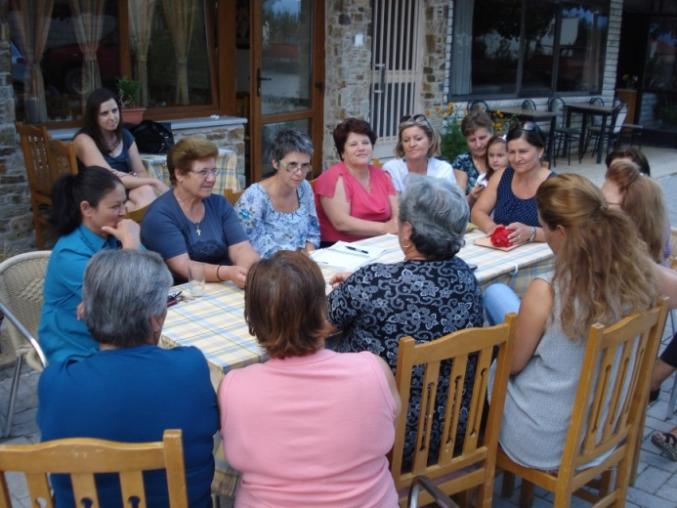
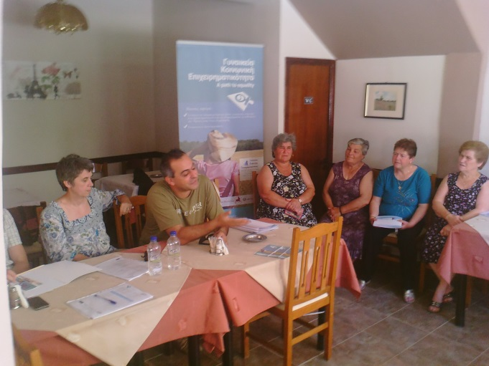
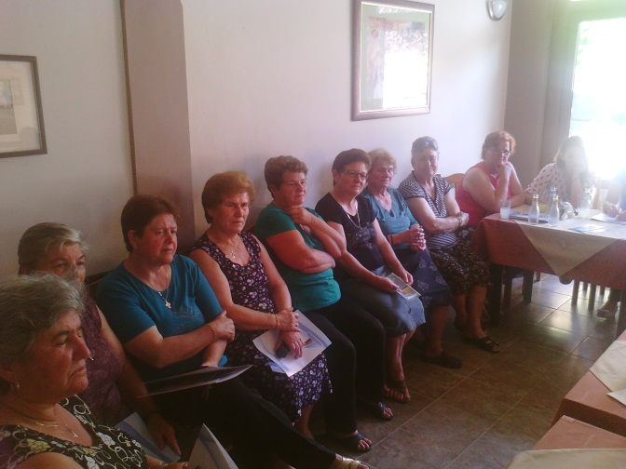
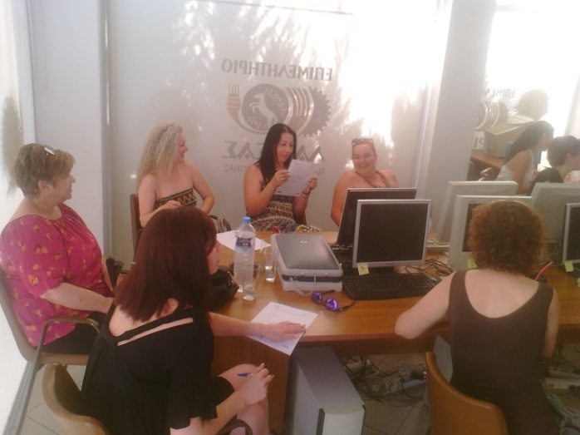
Consulting support activities
Area: Elassona, Greece
Participation: More than 100 women
Motivation: Establish a social enterprise
Activities: More than 50 consulting sessions (by individual and by group)
Area of support: Entrepreneurship, Accounting, Marketing,, Production of specific products etc.

Slide 6
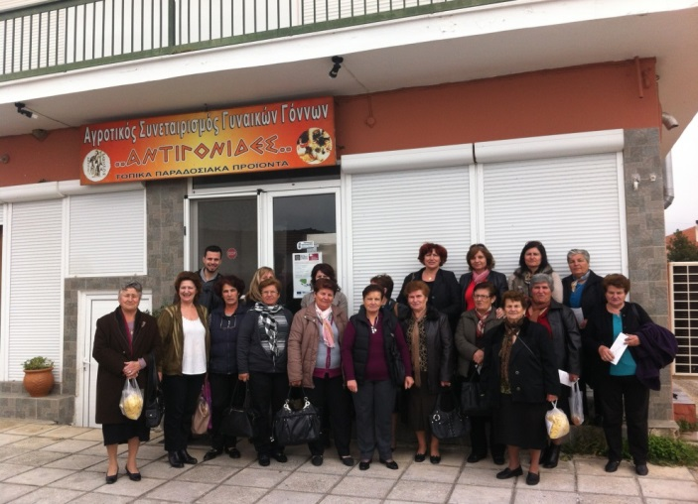
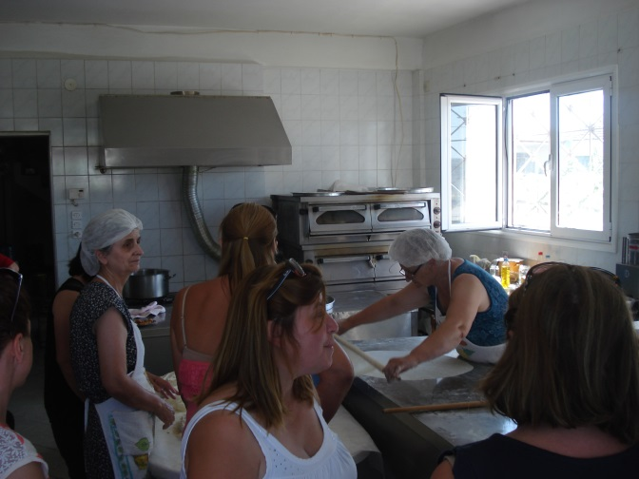
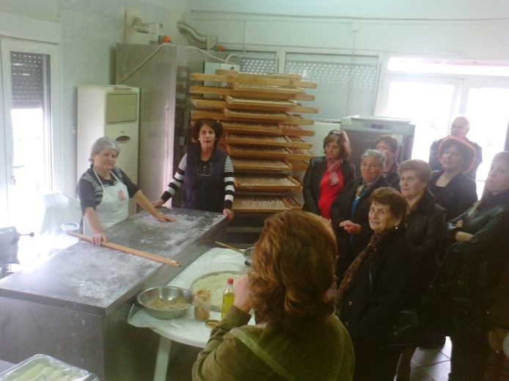
Visits to other social enterprises
Learning Outcomes:
How does a social enterprise work?
Which are the threats and the opportunities?
6 Visits to other Social Enterprises in the area of Thessaly
Results: Some of the women gave up the effort.
The others wanted even more to do this!

Slide 7
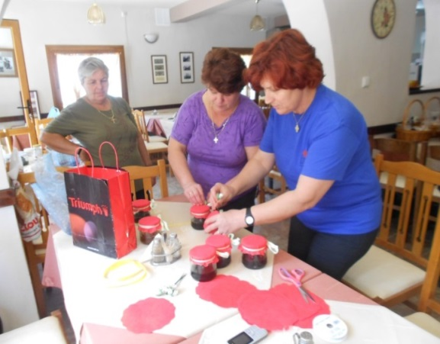
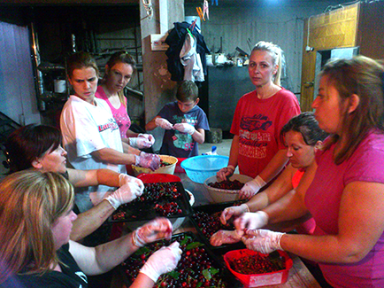
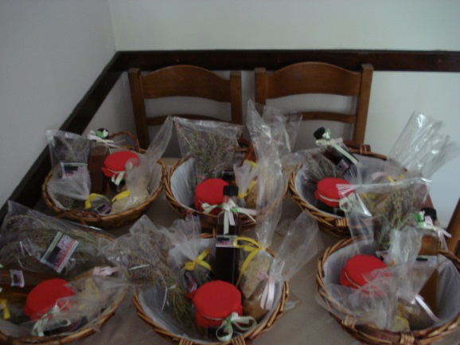
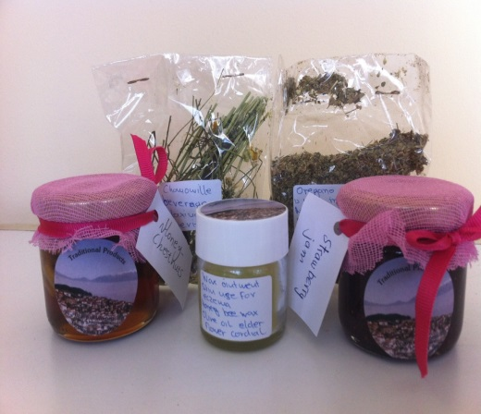
Entrepreneurial simulation
Cooperation
Work allocation
Real work conditions
Impressions
Feedback
Reengineering of the business ideas
Budget
Specific requirements
Time frame
Creation of a basket with local products
Identification of the possible product’s field

Slide 8
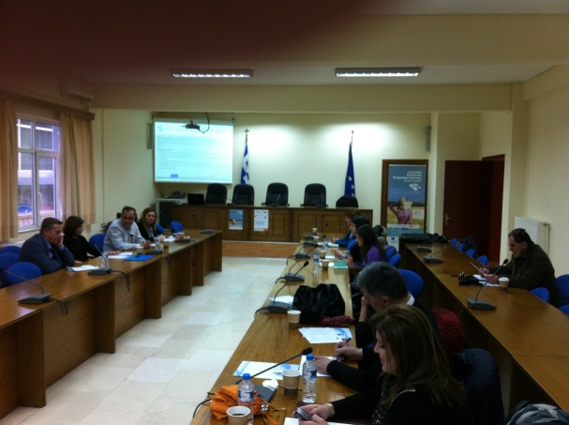
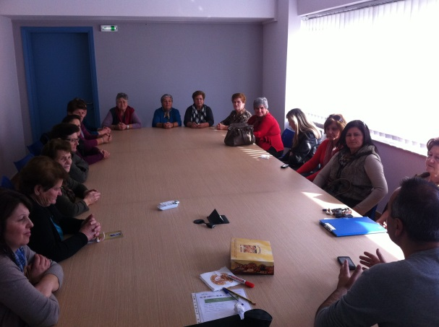
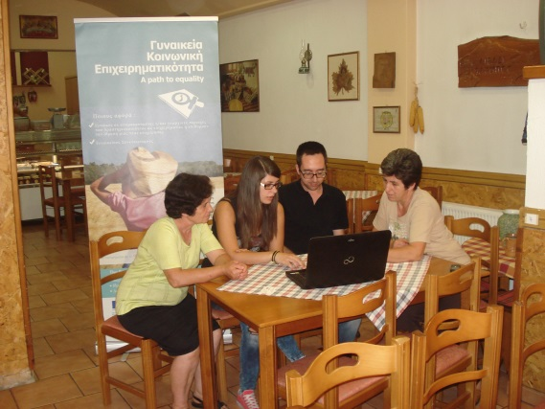
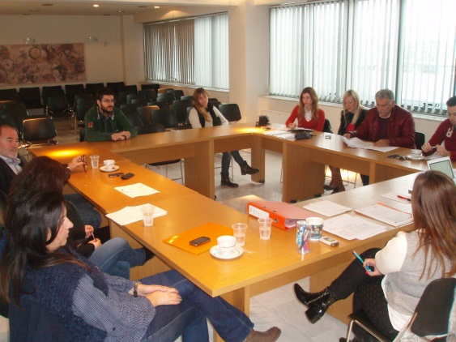
Workshops/events
Seminars for the consultants in order to support the women
Networking with other organizations and institutions
Workshops with the group of the women in specific areas
Dissemination activities

Slide 9
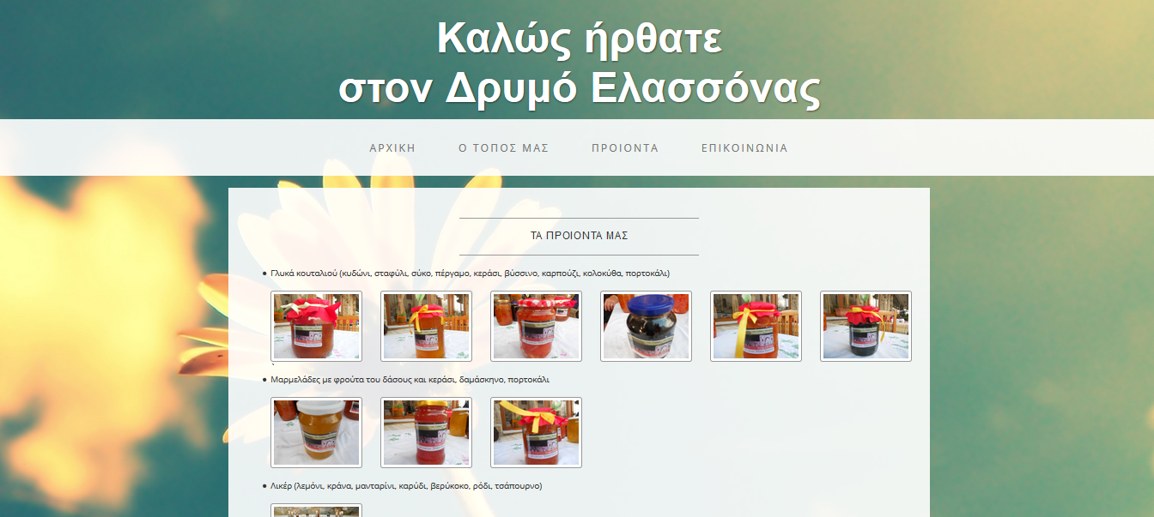

promotion activities
Flyer with all the information about the new established women social enterprise
Website for the promotion of the products

Slide 10
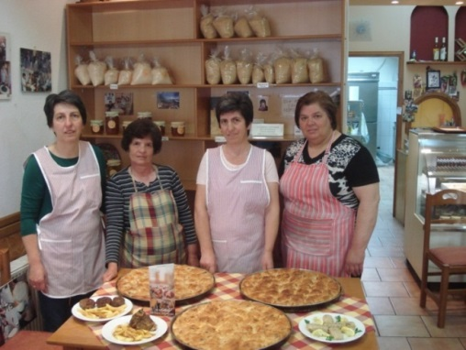
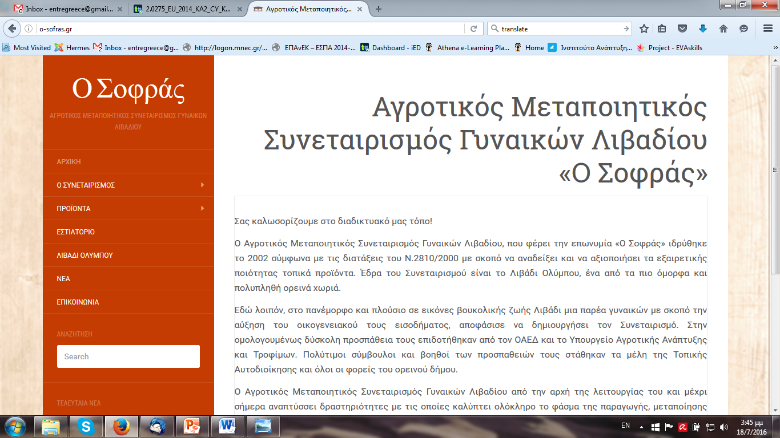
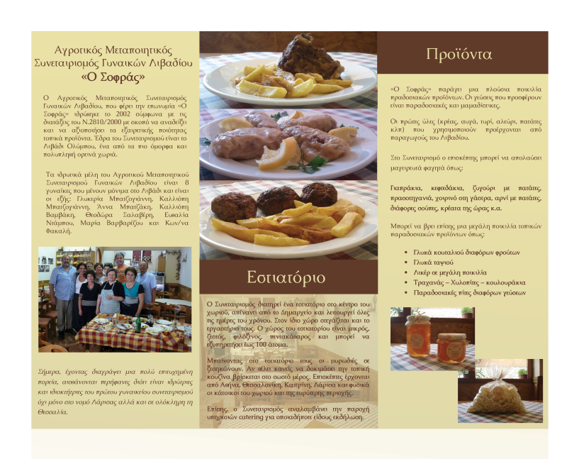
Supporting existing social enterprises
Manufacturing Agricultural Cooperative of women at Livadi
Vision: To highlight the high quality of local products and furthermore to assist the local women to supplement their income
Products: Pies, Liqueur, sweets, jams /Services: Restaurant and catering services
Activities by iED: Consulting sessions, flyer, website

Slide 11
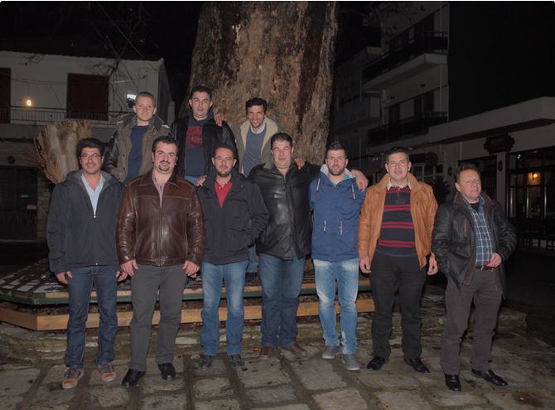

Supporting existing social enterprises
Shepherds Association of Livadi Olympus
Brief History: Was founded in 2007 by a group of young people. Headquartered in Livadi Olympus a village at 1200 m. altitude which hosts 60.000 goats.
Vision: To resist the urbanization, social and economic decline of our country and simultaneously to offer our fellow citizens, visitors and each Greek family local cheese and fresh local products.
Products: Traditional Cheese Products, Traditional Local Products, Feta Cheese for Greek salad (Protected Designation of Origin) With herbs from Olympus and extra virgin olive oil.
Services by iED: Consulting Sessions, Networking, Participation to EU projects

Slide 12
stages and target’s group interest
1. Contact
9. Mentoring to the final group
5. Visit to other social enterprises
6. Consulting sessions
7. Entrepreneurial Simulation
8. Networking
4. Consulting sessions (individually and group)
2. Consulting sessions (whole group)
3. Need analysis
≈30+
≈15
≈5

Slide 13
Institute of Entrepreneurship Development
60 Ir. Politechniou str. , 41335, Larissa, Greece
Tel./Fax: +30 2410 626 943
E-mail: info@entre.gr & info@ied.eu
Website: www.ied.eu

